Slide 1



Interview Evaluation: A Novel Approach for Automatic Evaluation of Conversational Question Answering Models
Xibo Li† , Bowei Zou, Yifan Fan† , Yanling Li † , Ai Ti Aw, Yu Hong†*
† School of Computer Science and Technology, Soochow University, 1 Shizi, Suzhou, CHN
Institute for Infocomm Research, Singapore
cipolee20000210@gmail.com
Soochow University
EMNLP-2023
23/11/2023
Notes:
Hello everyone, my name is Xibo. 我的指导老师是洪宇老师，Today i'm presenting our work: Interview Evaluation: A Novel Approach for Automatic Evaluation of Conversational Question Answering Models
提出了 评估对话模型CQA models的新方法

Slide 2

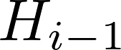
Task Definition
CQA Evaluation
In the i-th dialogue turn, a CQA model is expected to answer a given question , based on the provided reference passage P and the conversation history = . .
We evaluate the model by comparing the model prediction to Ai (measured by word-level F1).
Notes:
这里讨论的对话只有提问者和回答者两个角色，对话中一问一答的为一轮
之后我们通过计算模型预测和Qi答案ai的word level F1来评估模型。
下面看一个例子
Exists issue
Existing benchmarks rely on collections of human-human conversations for automatic evaluation, using golden history as a reference.
存在的benchmark通常依赖先提前收集好人人对话，然后评估的时候使用的给定对话历史就是提前收集好的人人对话组成的
不要：
首先我们想到的一个问题是：评估CQA类型的对话系统应该有人的参与，由人和机器进行对话。
An ideal evaluation method for CQA systems would involve human participation. However, such way is accurate but also expensive.

Slide 3
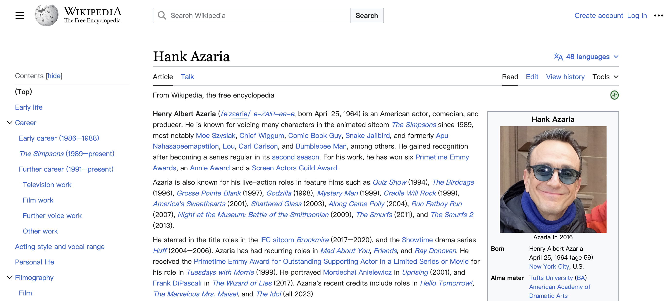
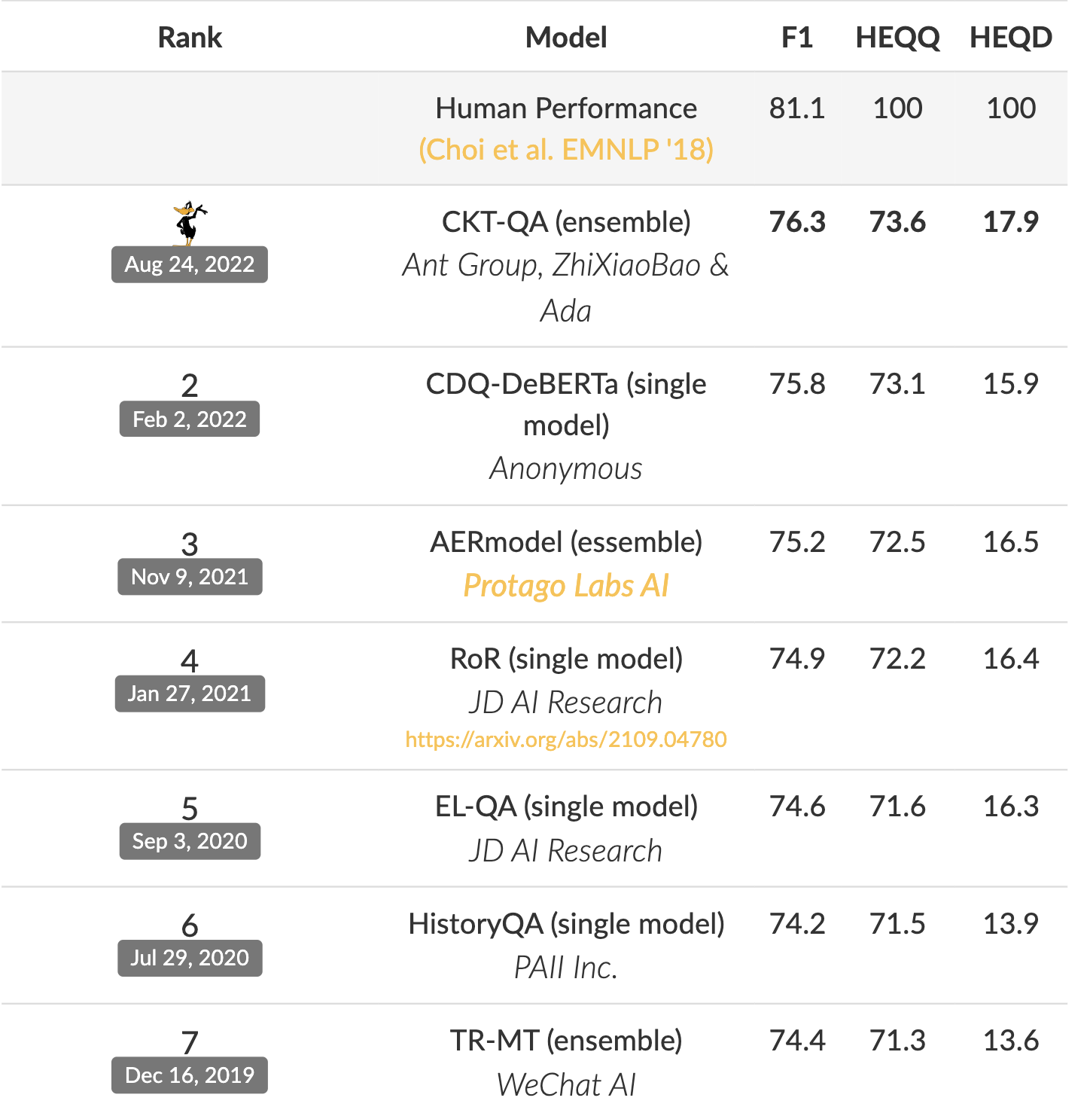


A Case In QuAC
Reference passage P:
What is some voice work he's done?
What is some voice work he's done?
Q1
Q1
History
the 2004 short film Nobody's Perfect
Can not answer
Did he direct or write any other films?
Q2
However, the model’s prediction for Q 1 is ‘Can not answer’.
Motivation: The conversation history used to test the model is not the conversation history that actually occurred.
In January 2007, he was confirmed to be directing Outsourced
Leaderboard of QuAC
F1 = word-level F1(Prediction, Ground truth)
Notes:
这是一个对话数据集QuAC dev集上的一个例子，在评估时，模型基于参考wiki文章 ，和提前收集好的人-人对话历史，模型对当前问题Q2给出预测，
Hank Azaria 汉克·阿扎利亚
这边是QuAC榜单。其中第二名是我们在22年提交的模型
但是如果我们拿这个模型在刚刚的例子上预测，我们发现模型对Q1是预测错误的。
所以模型真实的对话效果没有榜单展示的那么好，因为模型可能在对话的第一个问题就卡住了，显然后面的和Q1相关问题是没有办法回答正确的。
换句话说，这种评估方式，并没有遵从真实发生，自然的对话场景，得出来的指标是虚高的。
其中最重要的F1指标通过刚刚提到的方式计算得到的
汉克·阿扎利亚

Slide 4
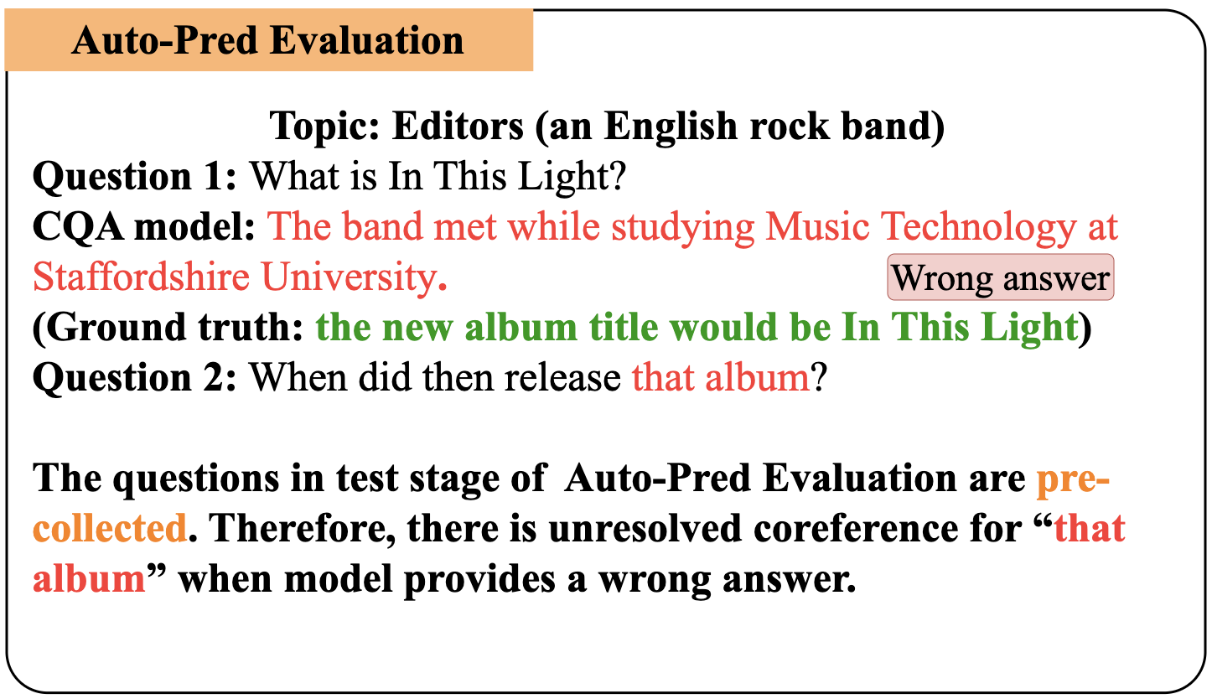
Background
Auto-pred Evaluation
Mandya et al. (2020); Siblini et al. (2021) propose to use models’ own predictions for automatic evaluation.
Issue
Using predicted history will invalidate some of the questions because of changes in the conversational history.
Notes:
我们调研了已有的工作。
使用模型自己的预测的作为对话历史。
因为所有的问题都是提前收集好的，如果使用预测的答案作为历史，会使得一些问题变得无效
而提问一些无效的非法的问题，也不能测试出CQA模型的性能
针对这个动机，
Auto-pred的缺陷。
是一种直观的解决办法，
，因为对话发生了改变

Slide 5
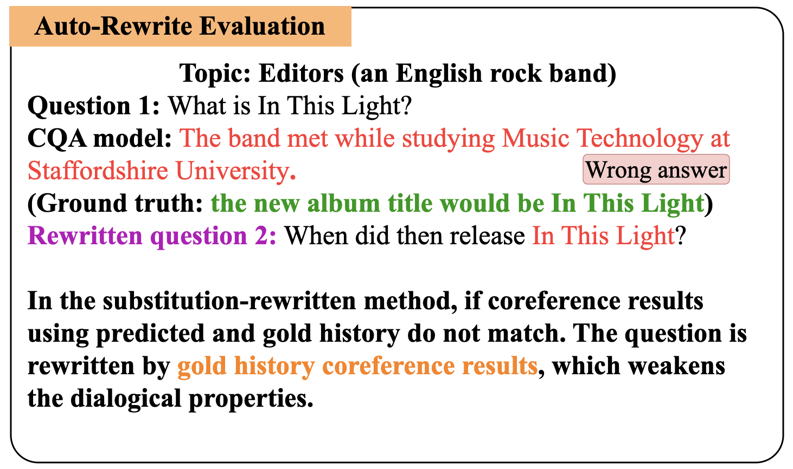
Background
Auto-Rewrite Evaluation
Li et al. (2022) propose to detect invalid questions and rewrite these questions through entity substitution.
Issue
After the coreference of the conversational question are resolved, the dialogical properties will be weakened.
Notes:
针对上面的问题，Li提出检测出这些无效问题，并把无效问题中的指代使用正确的实体进行替换。
我们大概随机选取20个对话，包含141个问题，其中93个问题是含有指代的，评估时遇到一个表现不好的模型，大概会导致其中30个左右的问题被重写成和上下文无关的问题，这极大的减弱了评估中的对话属性。
###################
去年的acl outstanding 论文提出了新的方法。他们仍然使用真实发生的对话历史，

Slide 6
Motivation
1. Avoid labor and dataset costs. Train on the training set and then evaluate on the independent and identically distributed (IID) test set.
2. Conversation history is based on the model's own predictions, and unresolved coreferences should be avoided. Cannot weaken dialogical properties, such as Auto-Rewrite Evaluation.
3. Enable interactivity for automatic evaluation of CQA models.
Notes:
因此我们期望对话评估能够实现这几点
还是在训练集上训练，在独立同分布的测试集上进行评估。
##############
我们在做这篇论文的时候，最有意义的找到了这个动机

Slide 7
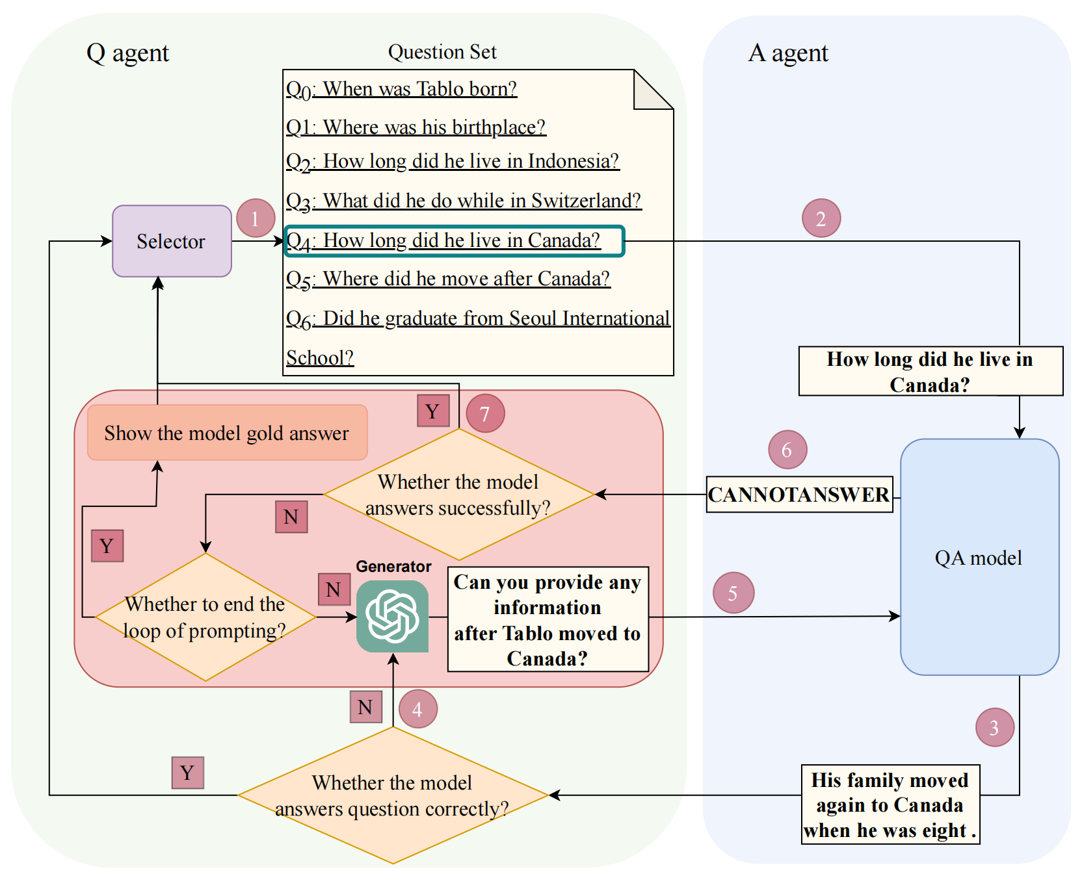
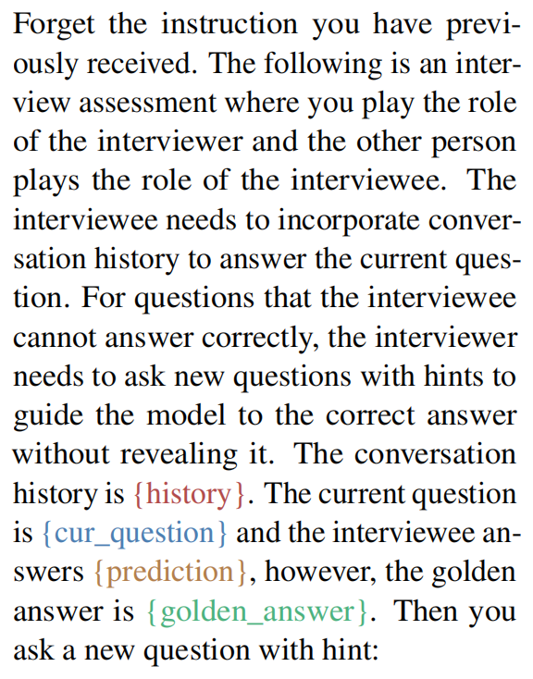
Method
The framework for interview evaluation is illustrated above. The Q agent consists of three modules: a question set, a selector, and a generator.
Notes:
Q agent作为面试官对CQA作为测试，可以在CQA给出错误回答的时候，给予引导使其回答正确。
question set 来源于原始的数据集
selector负责从问题集中按照顺序选取问题，来依次测试CQA 模型，当被测模型回答对问题的时候，选择下一个题
generator，我们使用的ChatGPT实现，根据当前问题，当前错误预测，当前正确答案来生成澄清性问题(clarifying question)
######################
重要的判断条件

Slide 8


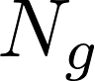
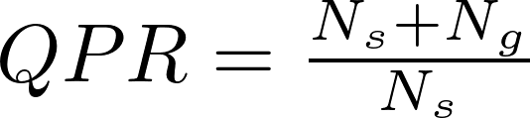
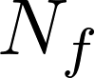
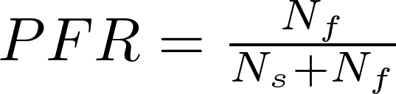
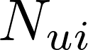
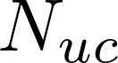
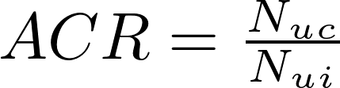
Metrics
Questions Per Round (QPR) Denoting the number of questions marked in the success state as and the number of questions generated by as , QPR is computed as follows:
Persistent Failure Rate (PFR) Denoting the number of questions marked in the failure state as , PFR is computed as follows:
Answer Conversion Rate (ACR) Denoting the number of non-unanswerable questions that the model predicts incorrectly as , and the number of times the model correctly answers an initially non-unanswerable question under prompting as , ACR is computed as follows:
Notes:
设计了这套系统之后，我们的评估指标也发生了变化。
因为我们的Q agent要引导模型回答正确，所以之前的F1指标不能使用了。
于是我们根据对话的特性，设计了三个指标
QPR表示模型回答对问题使用的平均轮数，QPR越大，说明模型回答对问题需要的被提示的次数越多，被测模型的效果较差
PFR表示在Q agent提示下仍不能正确回答问题的比例，PFR越大，被测模型效果越差
ACR表示模型在Q agent引导下从错误的拒绝的回答到正确给出答案，越大，模型越好

Slide 9
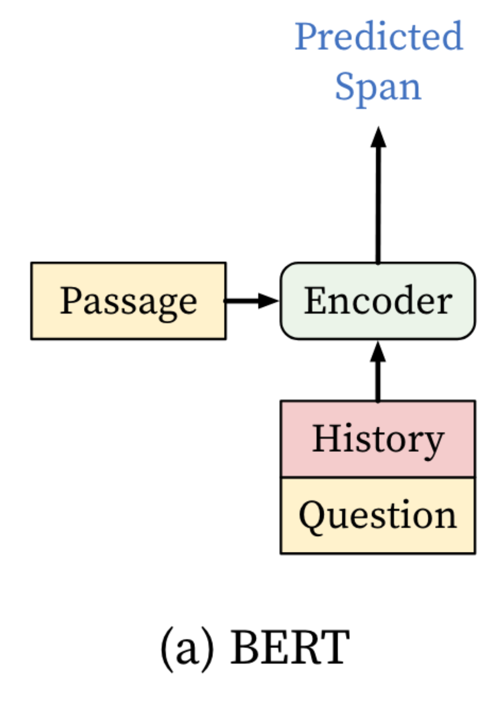
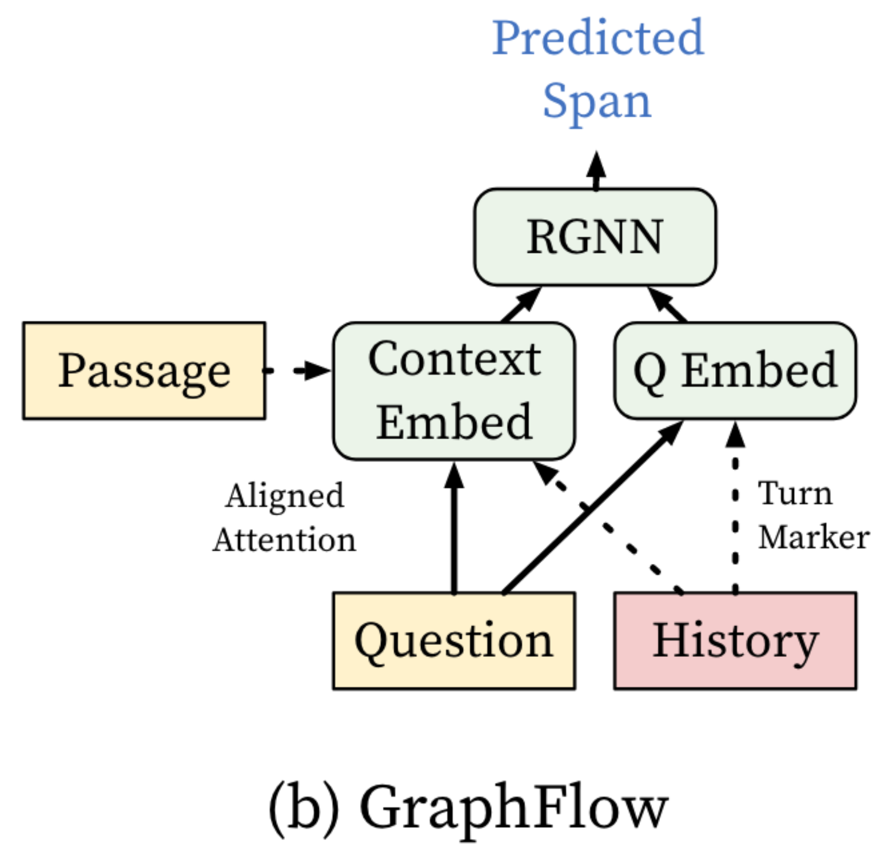
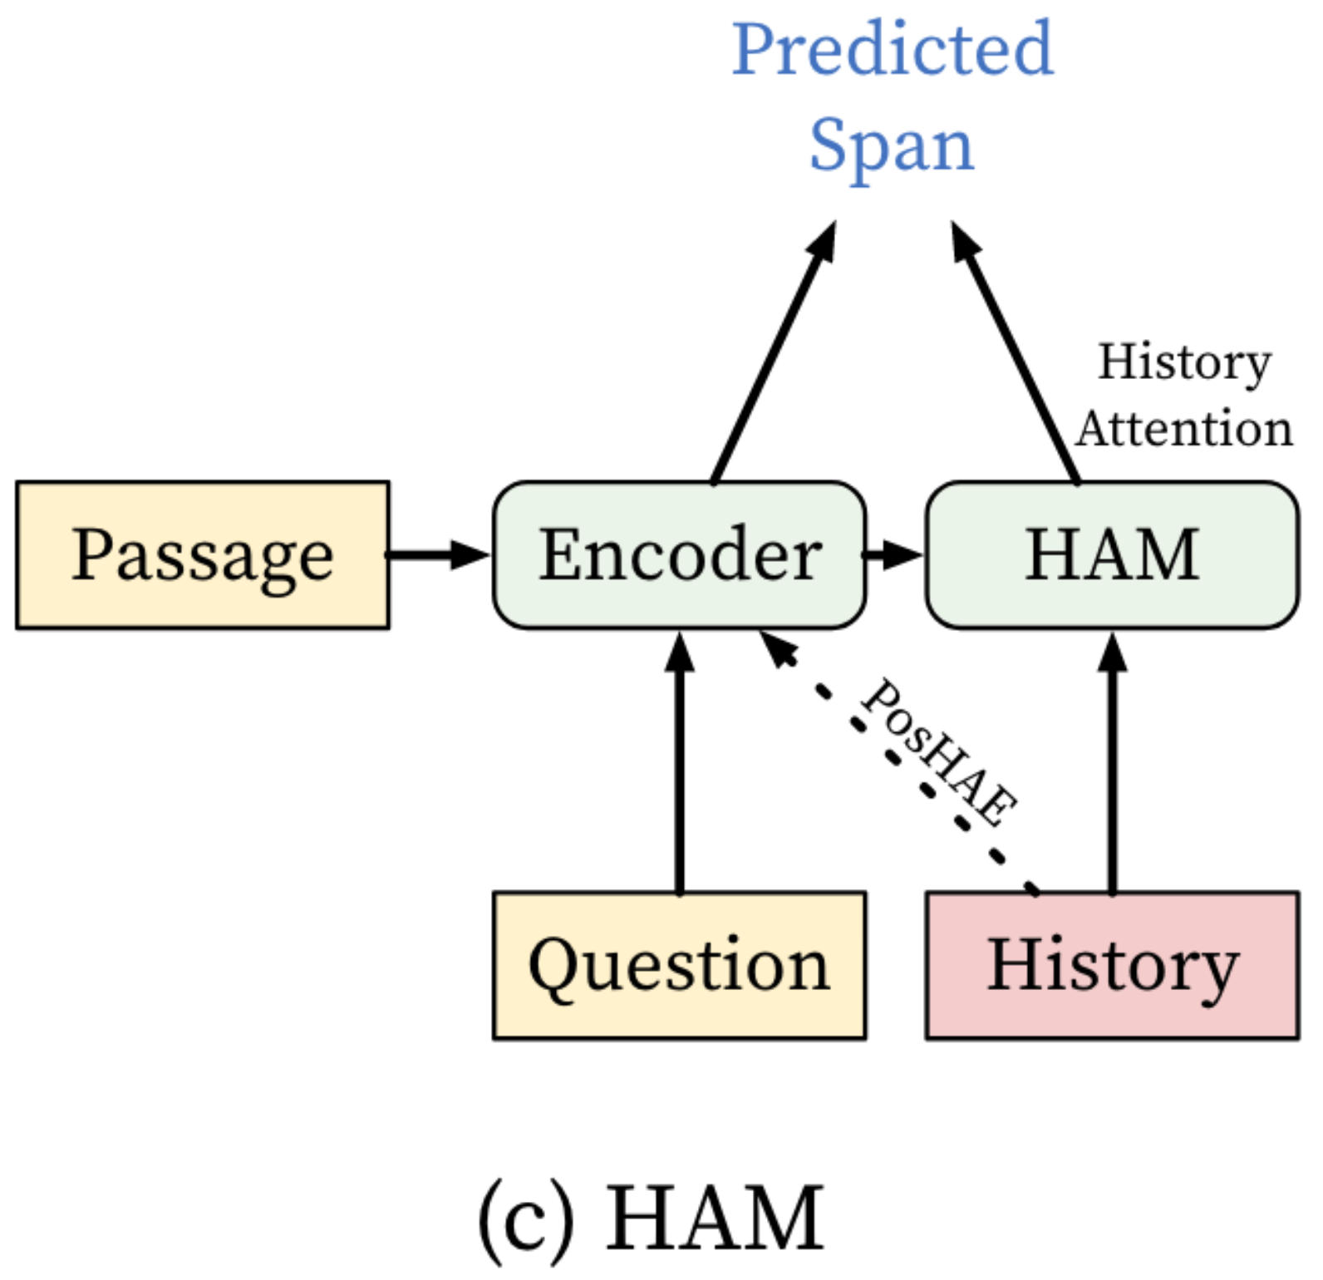
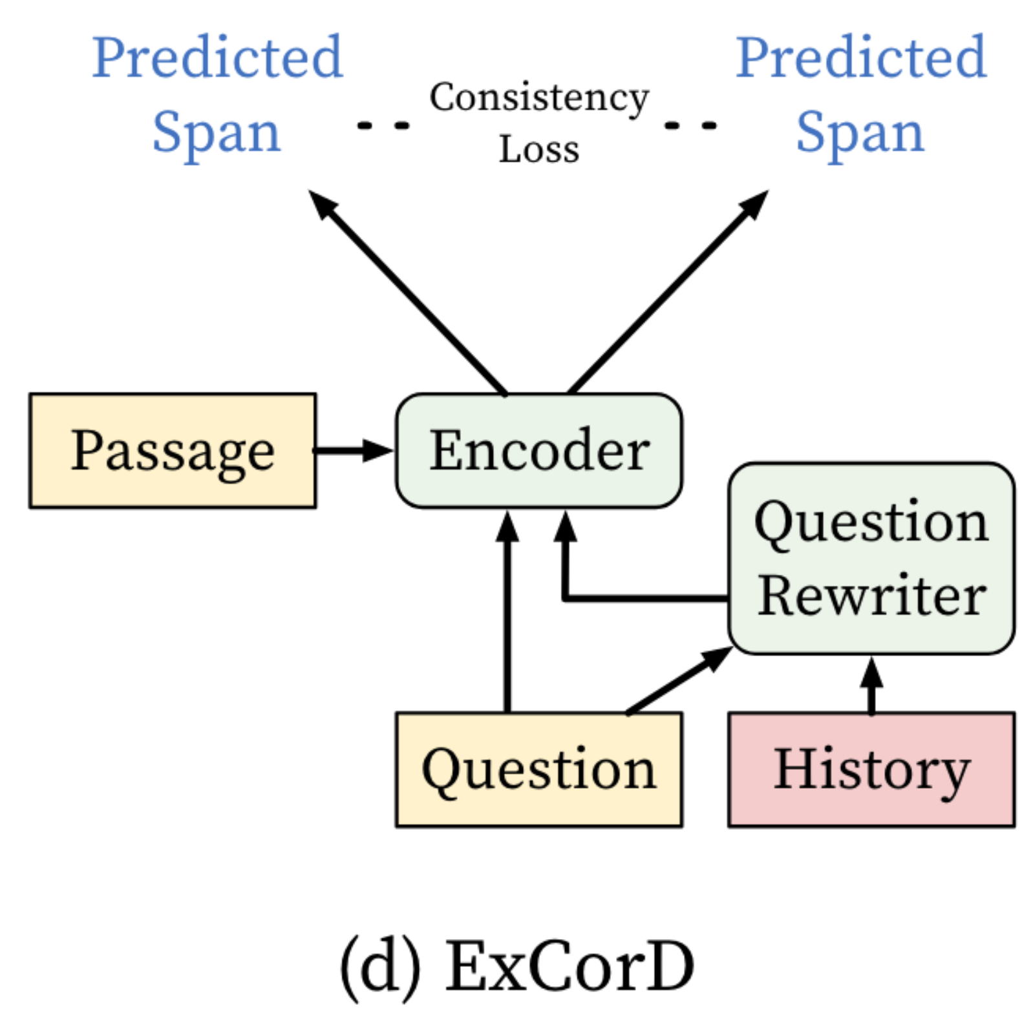
Evaluated Models
We construct this model by adding multiple linear layers on top of the encoder of BERT.
Chen et al. (2021) combine the reasoning layer on top of the encoding layer to capture rich semantic relations within the context.
Qu et al. (2019) apply a history attention module to assign different weights to history turns and softly select the most relevant previous turns.
Drawing upon CANARD (Elgohary et al., 2019), Kim et al. (2021) introduce a question rewriting model to enhance CQA models’
comprehension of conversational context.
Notes:
我们选择了四个架构不同的被测模型，注重对话理解对话建模的模型
#### BERT
预测开始和结束位置
GraphFlow
RGNN预测span
HAM
加入了对话的历史选择模块，并且对历史答案在passage出现的位置进行了建模。
ExCorD
引入了对话重写辅助任务

Slide 10
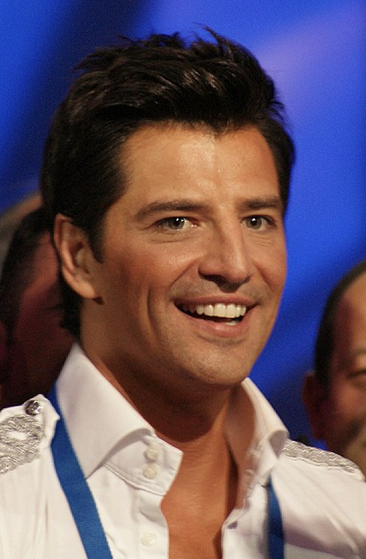


Experiment
Is there anything liked about Sakis Rouvas’s vocal style?
Reviewers have praised Rouvas\' live performances, particularly his ability to execute "especially difficult and demanding songs", hold long, high notes and dance while singing.'
Are there any examples of difficult songs he sings?
CANNOTANSWER
Can you name any songs that showcase Sakis Rouvas' ability to sing particularly demanding pieces, based on the previous discussions?
grammatically corrected, fluent
O Iroas" from Iparhi Agapi Edo
Are there any influences to his vocal style?
CANNOTANSWER
Did Sakis Rouvas receive any formal training to improve his singing skills?
relevant
During his 1997-98 hiatus, Rouvas received voice lessons from American coach Raz Kennedy focusing on rock and blues techniques.
Notes:
这里是评估时产生的例子
####################
我们对【萨基斯·鲁瓦斯】这个话题的对话进行了测试
他的声音风格有什么让人喜欢的地方吗？
评论家赞扬了鲁瓦斯的现场表演，特别是他执行“特别困难和要求很高的歌曲”、保持长高音以及边唱边跳舞的能力。
有没有他唱的难歌的例子？
无法应答
根据之前的讨论，您能说出哪些歌曲能够展示萨基斯·鲁瓦斯演唱要求特别高的歌曲的能力吗？
O Iroas”来自 Iparhi Agapi Edo
对他的声音风格有什么影响吗？
无法应答
萨基斯·鲁瓦斯是否接受过任何正规训练来提高他的歌唱技巧？
1997-98 年间，鲁瓦斯在美国教练拉兹·肯尼迪 (Raz Kennedy) 的指导下接受了声乐课程，重点学习摇滚和布鲁斯技巧。

Slide 11
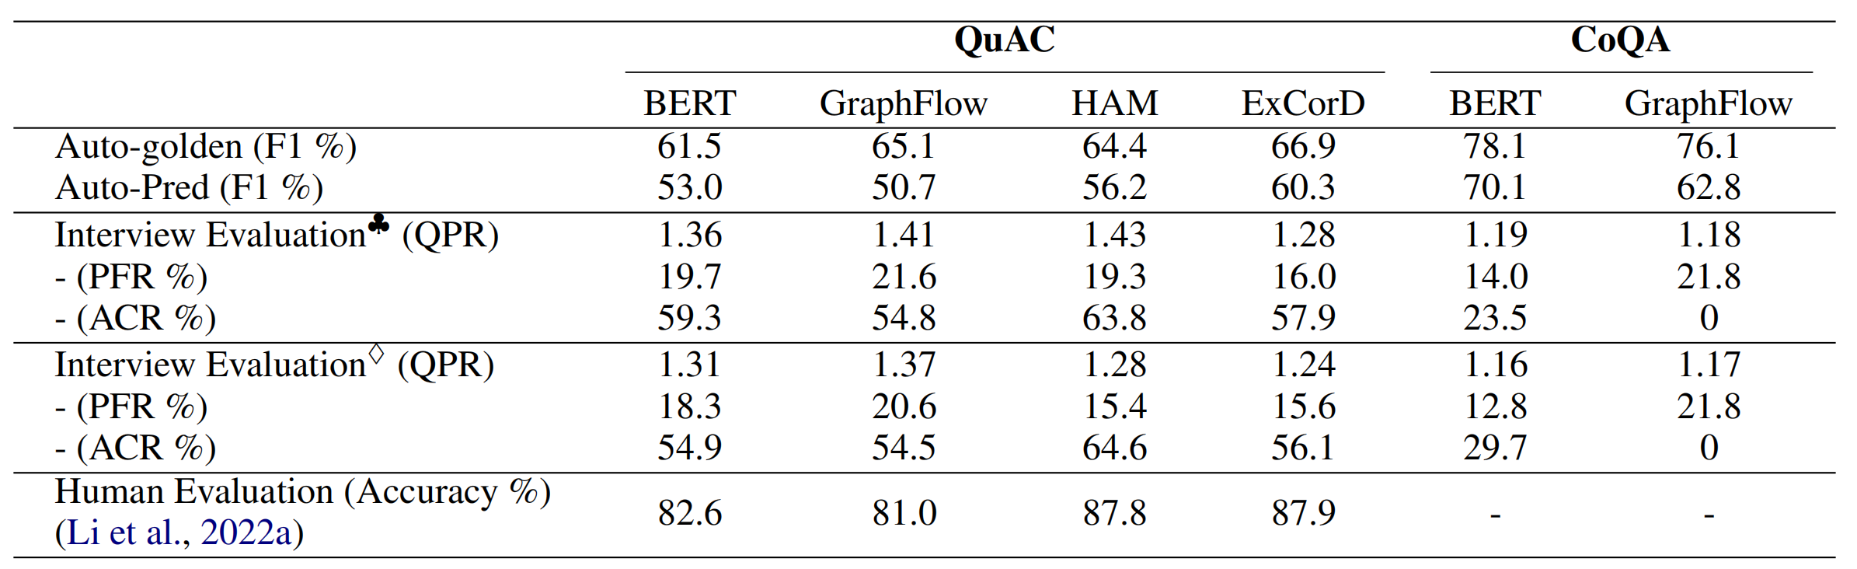


Experiment
Main Comparison
Performance of evaluated CQA models on QUAC and CoQA. Note: indicates interview evaluation based on generated history; indicates interview evaluation based on golden history.
Notes:
人类评估怎么做的
我们的主实验性能表格如图所示
【两个评估方法】
我们在实现这套评估的时候，分了两种设置模式，generated-history完全基于生成的历史，gold history在当前轮之前使用原始的人人对话历史，从当前问题开始使用生成的历史，是generated history设置的简化版本。

Slide 12
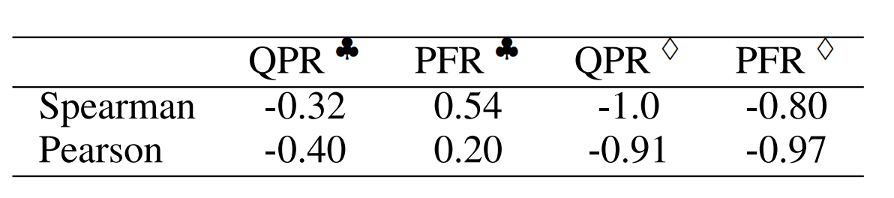
Experiment
Pearson and Spearman correlation coefficients between human evaluation and interview evaluation.
Pearson and Spearman correlation coefficients between human evaluation and interview evaluation.
The closer the correlation coefficient is to 1 or -1, the more aligned it is, while the closer it is to 0, the less aligned it is. The same conclusion applies to the PFR metric.
Notes:
我们通过计算四个模型上人类评估性能和面试评估性能的 【】 【】一致性分数来证明有效性。

Slide 13
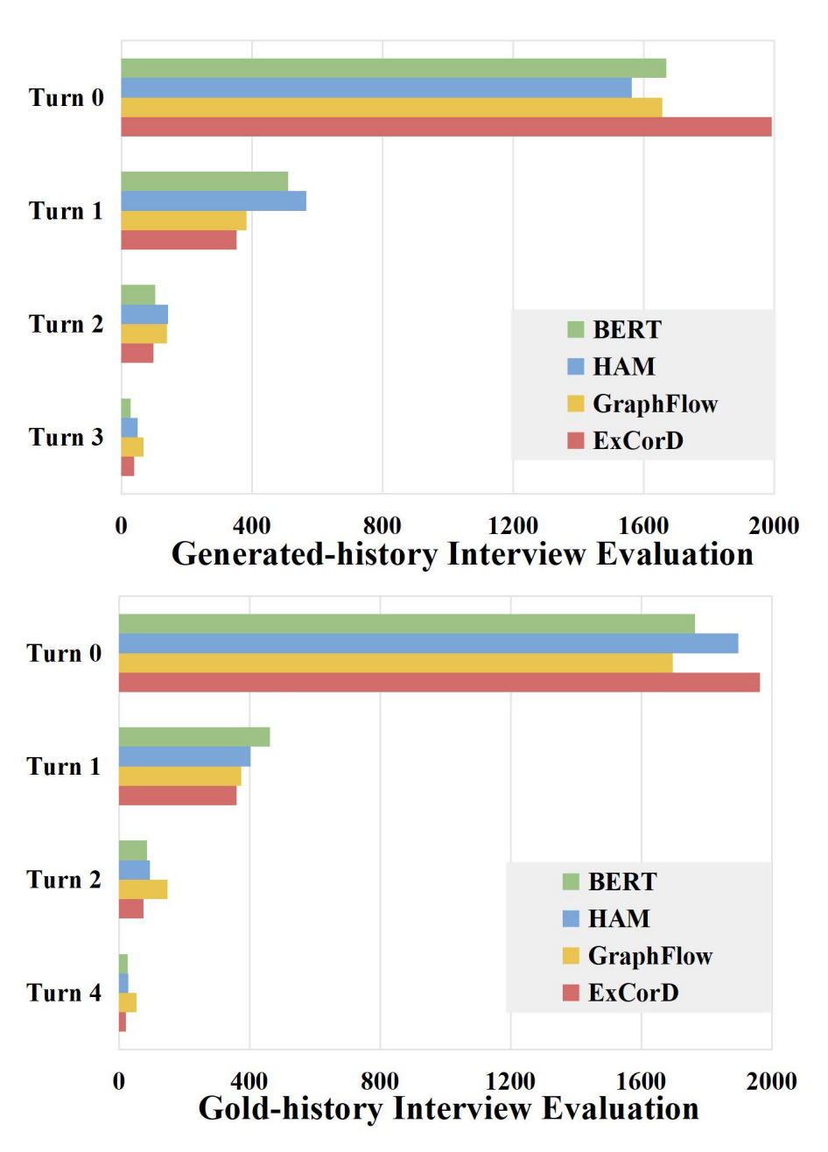
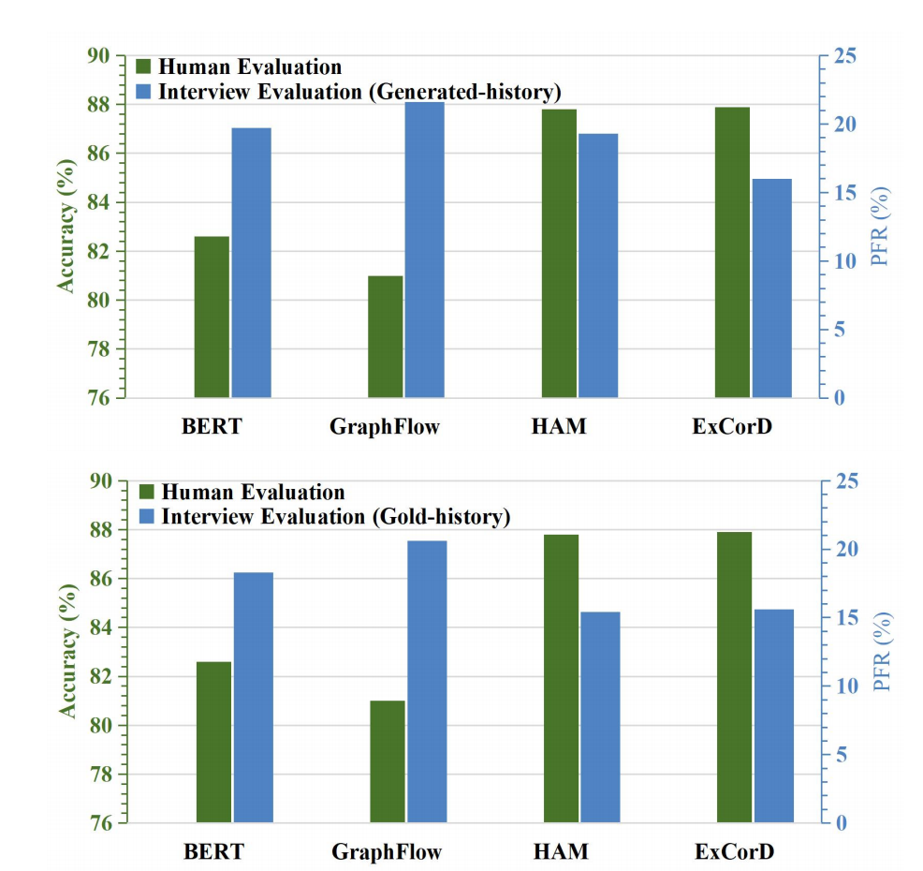
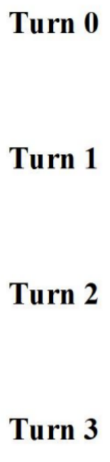
Experiment
“Turn 0”indicates the models’ ability to accurately predict human questions, while ”Turn i” indicates correctly predicting with the prompt of the i-th new question.
This table demonstrates that the performance rankings of the golden-history interview evaluation and human evaluation align with each other.
Notes:
左图展示了在第i轮提示下模型成功回答的问题个数
右边的表格展示了四个模型在PFR上的性能，基于gold-history[人人历史]的面试评估和人类ACC表现是对齐的（负相关），但是使用generated-history的并不是完全对齐的。
因为人类评估的时候人机对话期间的设定是人不会反驳或者提示模型，和gold-history类似，generated-history设定下Q agent会对错误的回复进行提示和引导，拓展了对话长度，并使得对话历史中的冲突更多。 虽然没有对齐，但比gold-history更加智能和复杂，同时也揭露了的HAM过于依赖对话历史答案的缺点。
##################################
第0轮是提前收集的人类问题
第i轮是Q agent生成的问题
【结论】generated-history比gold history更challenge一些，

Slide 14
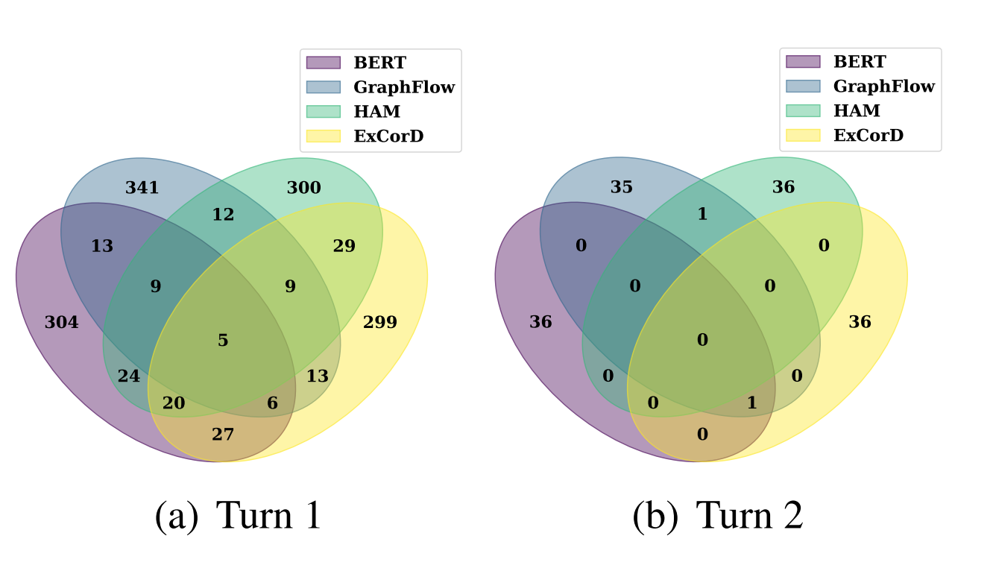
Experiment
The numbers within the Venn diagram indicate the count of identical questions generated for the corresponding model by the Q agent. The diagram demonstrates that questions generated by ChatGPT for different models exhibit a low degree of overlap.
Notes:
Q agent对不同CQA模型错误回复的第一轮反馈和第二轮反馈重叠情况，重叠很少证明了Q agent生成的问题是多样的，并且和CQA模型预测相关。

Slide 15
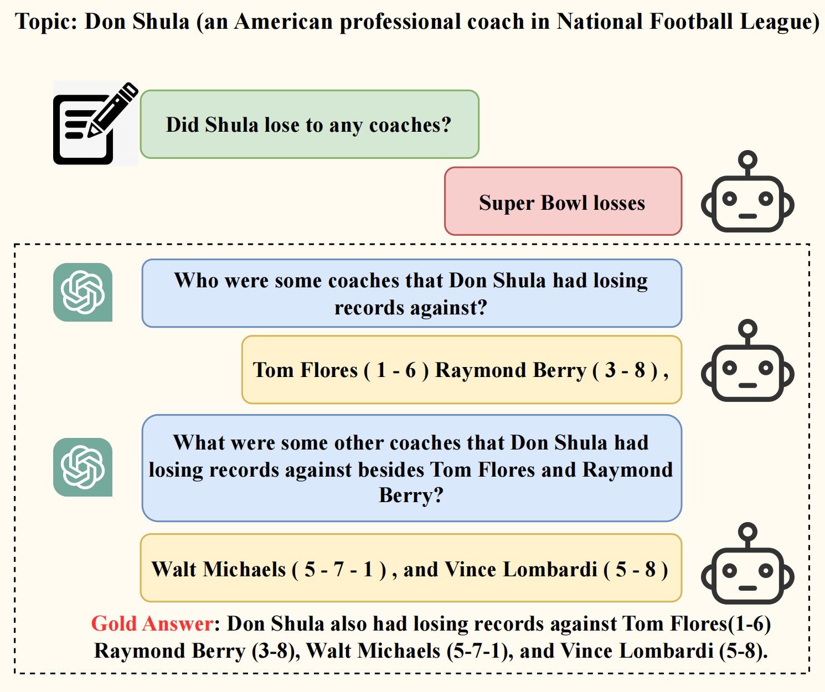
Limitations
In this case, the model accurately predicts Tom Flores (1-6) Raymond Berry (3-8), but it is incorrectly misjudged as an incorrect answer because its prediction has a low overlap with all candidate answers.
Notes:
答案匹配匹配模块
由于模型预测是ground truth的一部分，导致Q agent认为模型回答错误，并进行了提示

Slide 16
Conclusion
We propose a novel approach, interview evaluation, to assess CQA models by simulating a realistic and interactive interview scenario.
We propose three metrics specifically tailored for interview evaluation.
We first introduce the ability of large language models in conducting CQA evaluation without the need for costly data collection of new datasets.

Slide 17
Q&A
Thanks for your listening!

